Slide 1
Lawyer’s skill in capacity assessment: Lessons from case law
Lise Barry
Macquarie University Law School
Lise.barry@mq.edu.au

Slide 2
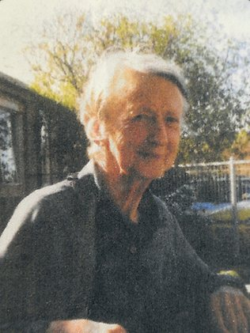
Nicholson v Knaggs [2009] VSC 64
Betty Dyke: http://www.news.com.au/breaking-news/charities-win-in-15m-elsbeth-betty-dyke-estate-saga/story-e6frfkp9-1226013990416

Slide 3
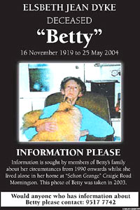
Elsbeth “Betty” Jean Dyke
Born in 1920, died 2004
No brothers, sisters or children
Loved and cared for by family and neighbours
Owner of substantial property
Lover of animals
Independent
Suffered with scoliosis and the effects of Alzheimers in her later years
34 trial days and 2 mediations
Dispute lasted until 2011
Costs of the dispute over $4 mill.
http://www.theage.com.au/national/neighbours-win-access-to-elderly-spinsters-will-20090227-8jr0.html

Slide 4
 | Will 1985 | Will 1999 | Will 2001
Executor | National Trustees Executors & Agency | Mr Wadeson Accountant, Mr Moffatt solicitor | Gary Smith, Robert Allen, Tim Knaggs & Brian Kollias solicitor
Peninsula animal aid | $200,000 | $0 | $0
Cat Protection Society | $20, 000 | $50,000 | $10,000
Blue Cross Animal | $30,000 | $0 | $0
RSPCA | $0 | $100,000 | $100,000
Denise and Tim Knaggs | $20,000 Denise only | 1/3 residuary | 1/3 residuary
Robert & Sandra Allen | $20,000 | 1/3 residual | 1/3 residual
Gary and Diane Smith | $40,000 | 1/3 residuary | 1/3 residuary
John and Judy Bailey | $30,000 | $60,000 | $20,000
Julie Nicholson | $0 | $10,000 | $0
Residual estate | Animal welfare, charities for disabled | Knaggs, Allen and Smith | Knaggs, Allen and Smith
Findings | Valid will – would be upheld if 1999 and 2001 wills not valid | Testamentary capacity BUT undue influence. Tim Knaggs excised | Not valid – Betty lacked testamentary capacity

Slide 5
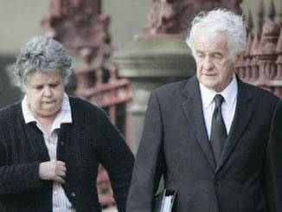
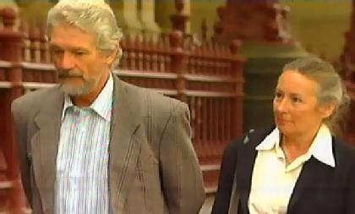
Julie and Colin Nicholson & Ors.
Julie and Colin Nicholson http://mornington-peninsula-leader.whereilive.com.au/news/story/recluse-millionaire-suffered-dementia-relative/
v
Timothy and Denise Knaggs & Ors.
Timothy and Denise Knaggs - http://www.theage.com.au/national/couple-pressured-vulnerable-woman-to-change-her-will-20090227-8kdb.html

Slide 6
United Nations Convention on the Rights of Persons with Disabilities, opened for signature 30 March 2007, 2515 UNTS 3 (entered into force 3 May 2008)
Art 12 (4) “States Parties shall ensure that all measures that relate to the exercise of legal capacity provide for appropriate and effective safeguards to prevent abuse in accordance with international human rights law. Such safeguards shall ensure that measures relating to the exercise of legal capacity respect the rights, will and preferences of the person, are free of conflict of interest and undue influence, are proportional and tailored to the person’s circumstances, apply for the shortest time possible and are subject to regular review by a competent, independent and impartial authority or judicial body. The safeguards shall be proportional to the degree to which such measures affect the person’s rights and interests.”

Slide 7
Legal Capacity in the CRPD
Right to make legal decisions to the full extent possible
Exercise all legal rights and obligations in your own right
Where a person requires support to exercise these rights – safeguards and monitoring
Intervention should be proportional
Decisions should represent will and preference of person
‘Background Conference Document Prepared by the Office of the United Nations High Commissioner for Human Rights’ paragraph 37 p. 20; See too: Report of the Fifth Session of the Ad Hoc Committee 23 February 2005, paragraphs 20 and 21 linked to www.un.org/disabilities/countries.asp?id=166

Slide 8
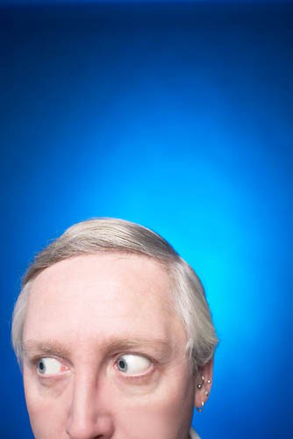
Assessing mediation capacity
Its not a single assessment but an ongoing one
Capacity is decision specific
Capacity to participate
Capacity to make decisions
Capacity to enter into a binding agreement

Slide 9
Medical Assessments
“the lines are now much more blurred than was earlier thought to be the case. In some cases a person suffering severe Alzheimer’s disease may retain testamentary capacity, while in other cases a person with mild dementia may not.”
Prof. Carmel Peisah

Slide 10
“Noddy syndrome”
“An affirmative answer to the question: Do you understand what this will contains? is not an adequate reflection of understanding. The client should be asked to explain the effect of what he or she is doing in his or her own words and it is important to record the responses verbatim” Professor Peisah
“ …you have no idea whether or not there is an actual understanding. And sometimes that can only be clarified by putting it back on to the patient so to speak and saying what do you intend and why for this person, who is this person ... it avoids a patient being overloaded, overwhelmed, by a mass of material and simply taking the way out that I alluded to elsewhere that sometimes [a patient] will mask [his or her] ignorance by simply agreeing.” Dr Lloyd

Slide 11
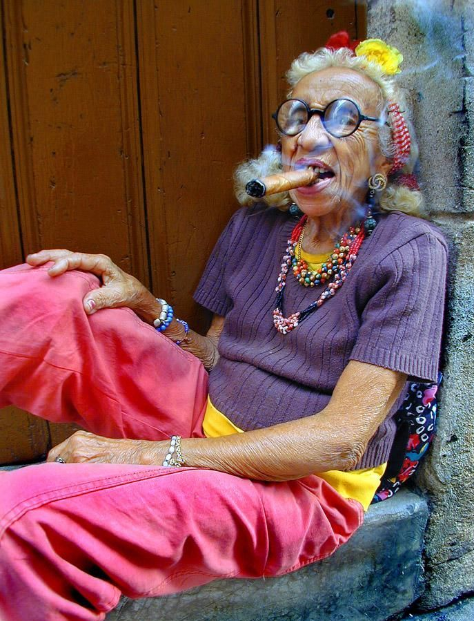
Re Estate of Griffith (Deceased)
“Testamentary capacity is not reserved for people who are wise, or fair, or reasonable, or whose values conform to generally accepted community standards. A person may disinherit a child for reasons that would shock the conscience of most ordinary members of the community, but that does not make the will invalid.”

Slide 12
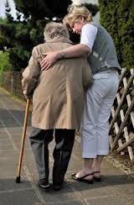
Undue influence
How independent is this decision?
How much choice does this person have?
Is this decision consistent with past behaviour and if not, why not?
Who else stands to profit from this decision?

Slide 13
“If a party appears to have difficulty comprehending the process, issues, or settlement options, or difficulty participating in a mediation, the mediator should explore the circumstances and potential accommodations, modifications or adjustments that would make possible the party’s capacity to comprehend, participate and exercise self-determination. ”
Model Standards of Conduct for Mediators, approved by the American Arbitrators Association (AAA), the American Bar Association (ABA), and the Association for Conflict Resolution (ACR)

